Slide 1
Receiving the Power!

Slide 2
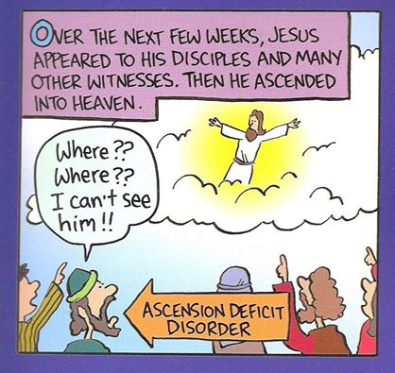

Slide 4
