Slide 1
Building Your House Upon the Rock
June 22, 2014

Slide 4
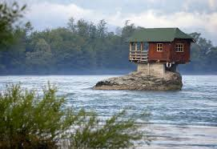

Slide 6
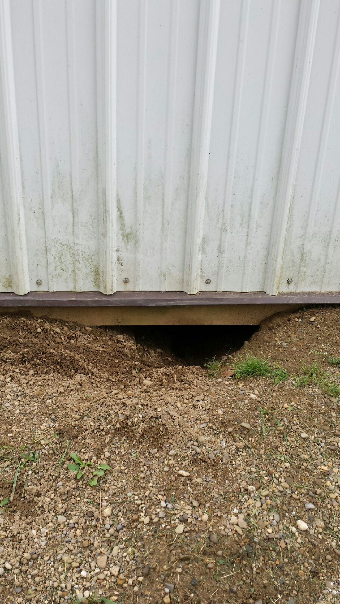

Slide 7
